Slide 1
Text Analysis

Slide 2
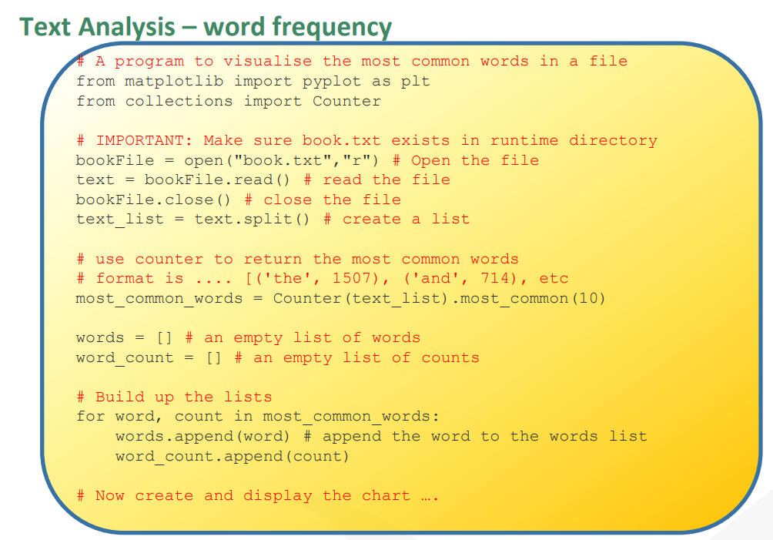

Slide 3
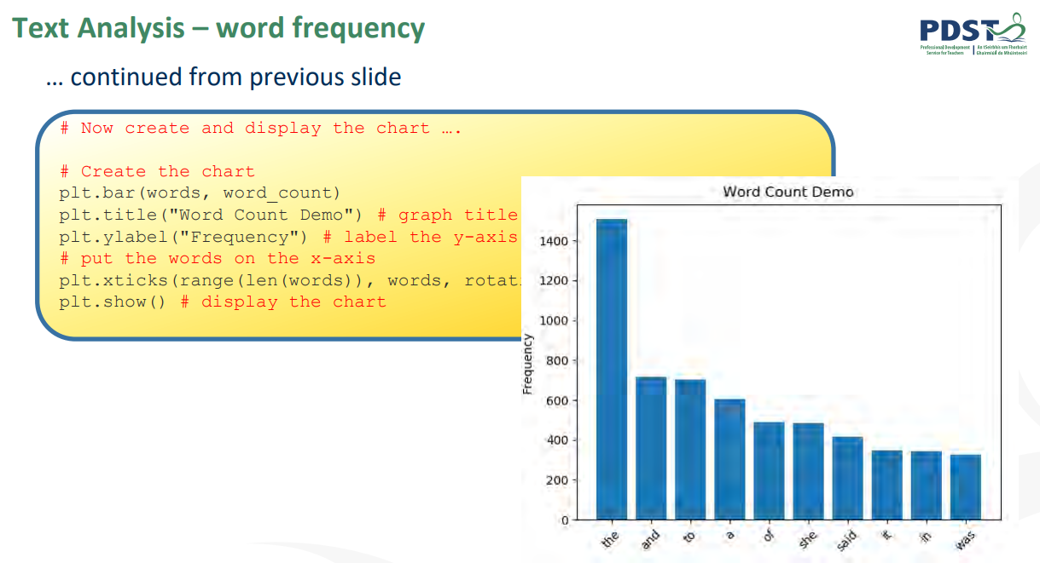

Slide 4
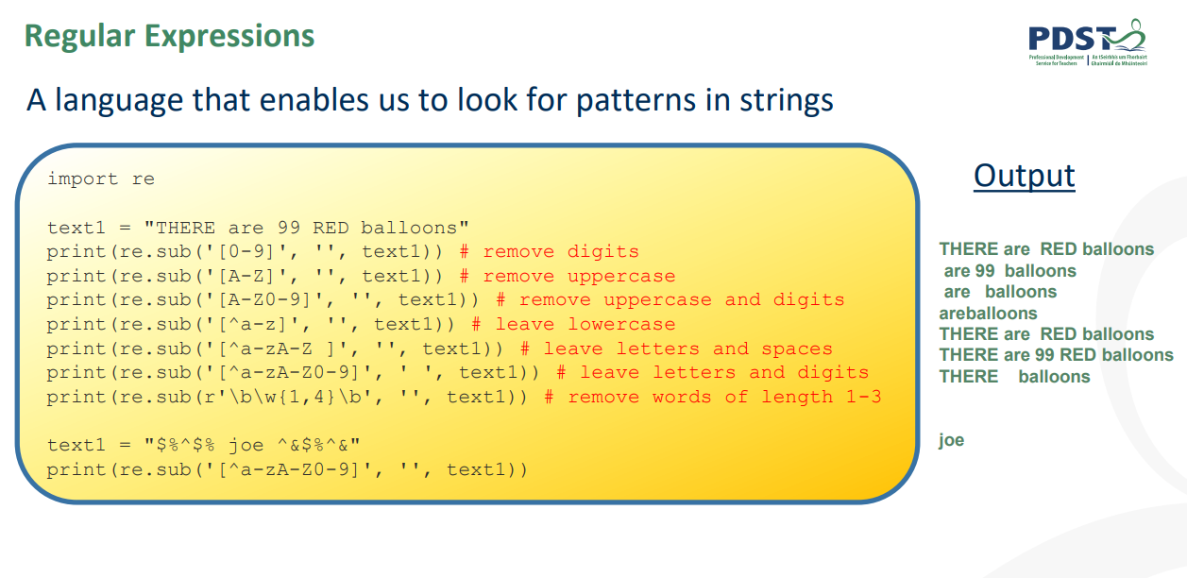

Slide 5
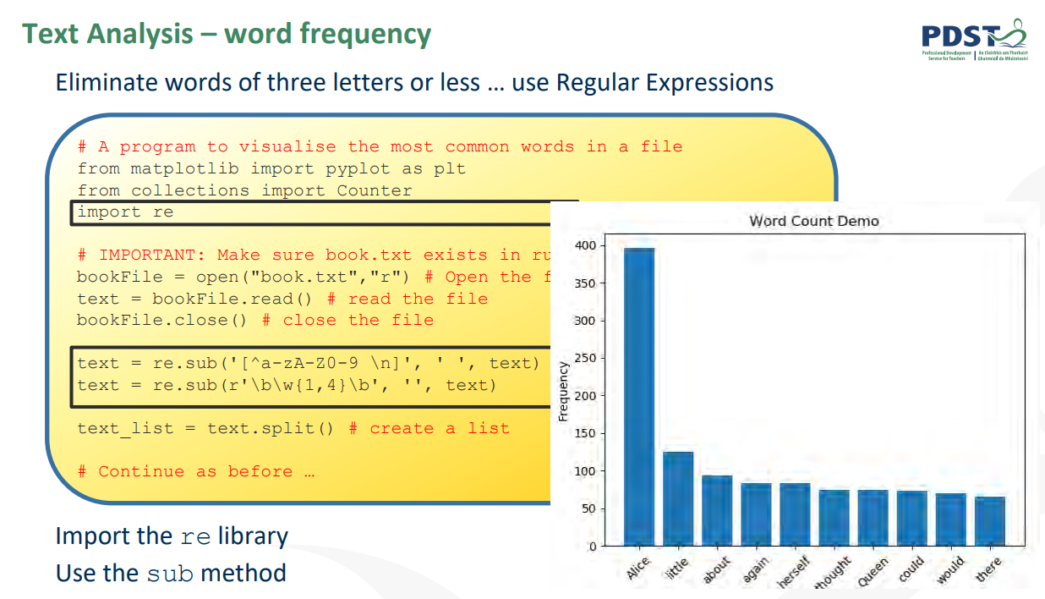

Slide 6
Readlines
https://www.w3schools.com/python/ref_file_readlines.asp

